Slide 1
SS G515 - Data Warehousing: Dimensional Modeling
Dr. Yashvardhan Sharma
Assistant Professor, CS & IS Dept.
BITS-Pilani

Slide 2
Factless fact tables
• Some fact tables quite simply have no measured facts!
• Are useful to describe events and coverage, i.e. the tables contain information that something has/has not happened.
• Often used to represent many-to-many relationships
• The only thing they contain is a concatenated key, they do still however represent a focal event which is identified by the combination of conditions referenced in the dimension tables
• There are two main types of factless fact tables:
– event tracking tables
– coverage tables

Slide 3
Factless Fact Tables
Facts are typically numeric measures
Events which record merely the coming together of dimensional entities at a particular moment
Student attending a class
A particular product on promotion
Can also be used to analyze what did not happen
Factless coverage fact table about all possibilities
Activity table about events that did happen
Subtract activity from coverage
Example: products that were on promotion but did not sell

Slide 4
Factless Fact Tables
Case studies that employ factless fact tables
Retail sales
Order management
Education

Slide 5
Retail sales
Retail sales schema can not answer an important question – What products were on promotion but did not sell?
Sale FT records only those SKUs that actually got sold
Not advisable to keep those SKUs in sales FT that did not sell (it is already huge!!)
Introduce promotion coverage fact table
Same keys as ales fact table
Grain is different
FT row represents a product that was on promotion regardless of whether the product sold
Factless fact table

Slide 6
Retail sales
What products were on promotion but did not sell?
Two step process:
Query the promotion coverage FFT to determine all the products that were on promotion on a given day
Find out all products that sold on a given day
Difference of these two lists!!
Try writing SQL query for this!

Slide 7
Order Management
Customer/representative assignment
Representatives are assigned to customers and it is not necessary that every assignment would lead to a sale
Sales Rep-Customer Assignment Fact
Assignment Effective Data Key(FK)
Assignment Expiration Data Key(FK)
Sales Rep Key (FK)
Customer Key (FK)
Customer Assignment Counter = 1
Date Dimension (views for 2 roles)
Sales Rep Dimension
Customer Dimension
Figure taken from Kibmall’s book – The Data Warehouse Toolkit, 3e

Slide 8
Order Management
Sales rep coverage factless fact table
Allows us to answer queries like which assignments never resulted in sales
Sales Rep-Customer Assignment Fact
Assignment Effective Data Key(FK)
Assignment Expiration Data Key(FK)
Sales Rep Key (FK)
Customer Key (FK)
Customer Assignment Counter = 1
Date Dimension (views for 2 roles)
Sales Rep Dimension
Customer Dimension
Figure taken from Kibmall’s book – The Data Warehouse Toolkit, 3e

Slide 9
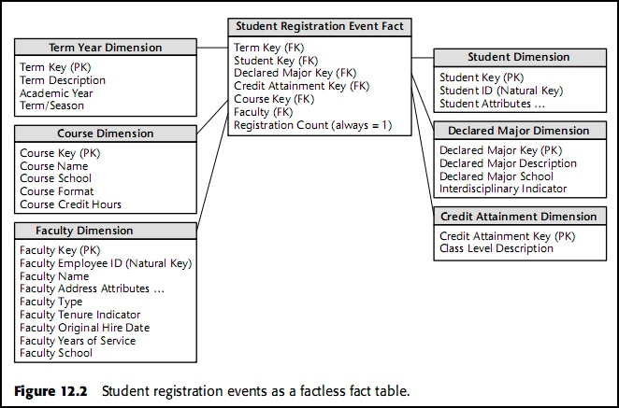
Education
Student Registration
Figure taken from Kibmall’s book – The Data Warehouse Toolkit, 2e

Slide 10
Education
Student Attendance
What about events that did not happen?
Attendance count = 0 or 1
Ceases to be factless fact table
Reasonable approach in this case
Student Attendance Fact
Day Hour Key(FK)
Student Key(FK)
Course Key (FK)
Faculty Key (FK)
Facility Key (FK)
Attendance count = 1
Day_Hour Dimension
Student Dimension
Course Dimension
Faculty Dimension
Facility Dimension
Figure taken from Kibmall’s book – The Data Warehouse Toolkit, 3e

Slide 11
Factless Fact Tables: Summary
Records events which do not have associated facts
Dummy fact = 1 to increase readability of SQL queries
select faculty, SUM(registration count)….
Group By Faculty
Used in retails sales, order management, education etc.
In some situations, events that did not happen can also be recorded, but then the fact table ceases to be factless

Slide 12
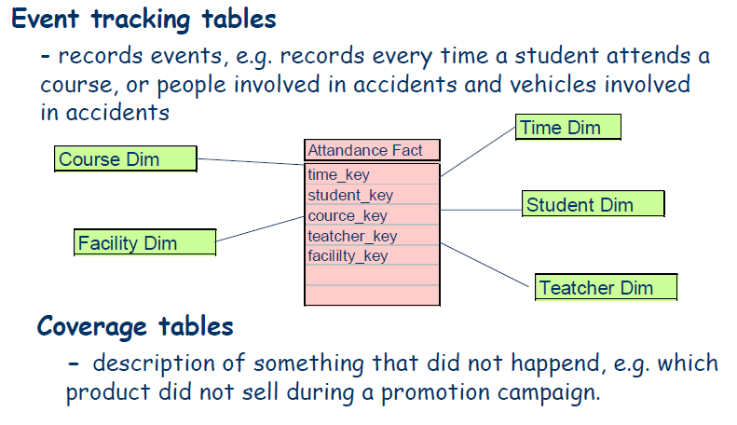
Factless fact tables

Slide 13
Changing Dimensions
Slowly Changing Dimensions
Rapidly Changing Dimensions
Small Dimensions
Monster Dimensions

Slide 14
Slowly Changing Dimensions

Slide 15
Why?
Let’s take Sales fact table for example
Every day more and more sales take place, hence:
More and more rows are added to the fact table
Very rarely are the rows in the fact table updated with changes
Also Consider...
How will we adjust the fact table when changes are made?

Slide 16
Why? cont’…
Consider the dimension tables
Compared to the fact tables, they are more stable and less volatile
However, unlike fact tables, a dimension table does not change just through the increase of number of rows, but also through changes to the attributes themselves

Slide 17
We will focus on (Slowly Changing) Dimensions
When? Good question:
Inside the ETL process
After the ETL process, as a stored procedure

Slide 18
From what we discussed for now, we can derive these principles:
Most dimensions are generally constant over time
Many dimensions, through not constant over time, change slowly
The product (business) key of the source record does not change
The description and other attributes change slowly over time
In the source OLTP system, the new values overwrite the old ones
Overwriting of dimension table attributes is not always the appropriate option in a data warehouse
The ways changes are made to the dimension tables depend on the types of changes and what information must be preserved in the DWH

Slide 19
How? 3 Answers:
The usual changes to dimension tables are classified into three types
Type 1 (Overwrite)
Type 2 (Adding a row)
Type 3 (Adding a column)
We will consider the points discussed earlier when deciding which type to use

Slide 20
Slowly Changing Dimensions
For example, the product or customer dimension
The assumption: the key does not change, but
some of the attributes does.
Type 1: Overwrite the dimension record with the
new values, thereby losing history
Type 2: Create a new additional dimension record
using a new value of the surrogate key
Type 3: Create a new field in the dimension record to store the new value of the attribute

Slide 21
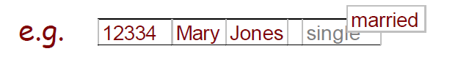
Type 1
Overwrite the old value of an attribute with a new one
+ easy to implement
- avoids the real goal, which is to accurately track history

Slide 22
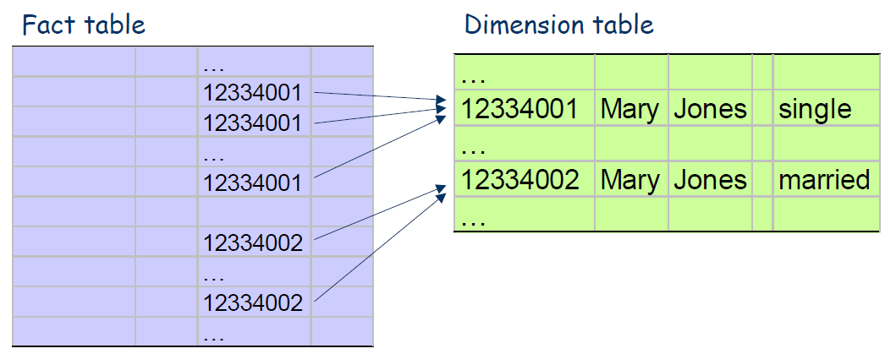
Type 2
Create a new additional dimension record
• A generalised (surrogate) key is required (which is a responsibility of the data warehouse team)

Slide 23
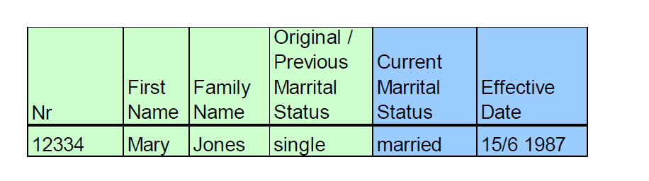
Type 3
Create a new field in the dimension record

Slide 24
Surrogate Key
A surrogate key is a unique identifier for the entity in the modeled world
It is not derived from application data
It’s not meant to be shown outside the DWH
It’s only significance is to act as the primary key
Frequently it’s a sequential number (Sequence in Oracle or Identity in SQL Server)

Slide 25
Surrogate Key
Having the key independent of all other columns insulates the database relationships from changes in the data values or database design (making the database more agile) and guarantees uniqueness
For example: An employee ID is chosen as the neutral (business) key of an employee DWH. Because of a merger with another company, new employees from the merged company must be inserted. There is one employee who works in both companies…
If the key is a compound key, joining is more expensive because there are multiple columns to compare. Surrogate keys are always contained in a single column

Slide 26
Our example
For the demonstration, we’ll use this star schema:
Customer
Customer Key
Customer Name
Customer Code
Martial Status
Address
State
Zip
Product
Product Key
Product Name
Product Code
Product Line
Brand
Order fact
Product Key
Time Key
Customer Key
Salesperson Key
Order Dollars
Cost Dollars
Margin Dollars
Sale Units
Time
Time Key
Date
Month
Quarter
Year
Salesperson
Salesperson Key
S.person Name
Territory Name
Region Name

Slide 27
Type 1 Changes
Usually relate to corrections of errors in the source system
For example, the customer dimension: Mickey Schreiber -> Miky Schreiber

Slide 28
Type 1 Changes, cont.
General Principles for Type 1 changes:
Usually, the changes relate to correction of errors in the source system
Sometimes the change in the source system has no significance
The old value in the source system needs to be discarded
The change in the source system need not be preserved in the DWH
Also Consider…
What will happen when only the last value before the change is needed?

Slide 29
Applying Type 1 changes
Change Box
Customer Code:
K12356
Customer Name:
Miky Schreiber
Key Restructuring
K12356 -> 33154112
Before
After
Customer Key:
Customer Name:
Customer Code:
Martial Status:
Address:
33154112
Mickey Schreiber
K12356
Married
Negba 11 ST
33154112
Miky Schreiber
K12356
Married
Negba 11 ST

Slide 30
Type 1 Changes
Overwrite the attribute value in the dimension table row with the new value
The old value of the attribute is not preserved
No other changes are made in the dimension table row
The key of this dimension table or any other key values are not affected
Easiest to implement

Slide 31
Type 2 Changes
Let’s look at the martial status of Miky Schreiber
One the DWH’s requirements is to track orders by martial status (in addition to other attributes)
All changes before 11/10/2004 will be under Martial Status = Single, and all changes after that date will be under Martial Status = Married
We need to aggregate the orders before and after the marriage separately
Let’s make life harder:
Miky is living in Negba st., but on 30/8/2009 he moves to Avivim st.

Slide 32
Type 2 Changes, cont.
General Principles for Type 2 changes:
They usually relate to true changes in source systems
There is a need to preserve history in the DWH
This type of change partitions the history in the DWH
Every change for the same attributes must be preserved
Also Consider…
Must we track changes for all the attributes?
For which attributes will we track changes? What are the considerations?

Slide 33
Applying Type 2 changes
Change Box
Customer Code:
K12356
Martial Status (11/10/2004):
Married
Address (30/8/2009):
Avivim st.
Key Restructuring
K12356 -> 33154112
51141234
52789342
Before
After 11/10/2004
After 30/8/2009
Customer Key:
Customer Name:
Customer Code:
Martial Status:
Address:
33154112
Miky Schreiber
K12356
Single
Negba 11 ST
51141234
Miky Schreiber
K12356
Married
Negba 11 ST
52789342
Miky Schreiber
K12356
Married
Avivim st.
Also Consider…
What will happen if in addition to Address we also have State, zip code?
What will happen if the customer code will change?

Slide 34
Type 2 concluded
The steps:
Add a new dimension table row with the new value of the changed attribute
An effective date will be included in the dimension table
There are no changes to the original row in the dimension table
The key of the original row is not affected
The new row is inserted with a new surrogate key
Also Consider…
What is the data type of the effective date column? Must it contain both date and time?
How will the surrogate key be built?
Advantages? Disadvantages?

Slide 35
Type 3 Changes
Not common at all
Complex queries on type-2 3 changes may be
Hard to implement
Time-consuming
Hard to maintain
We want to track history without lifting heavy burden
There are many soft changes and we don’t care for the “far” history

Slide 36
Type 3 Changes
General Principles:
They usually relate to “soft” or tentative changes in the source systems
There is a need to keep track of history with old and new values of the changes attribute
They are used to compare performances across the transition
They provide the ability to track forward and backward

Slide 37
Applying Type 3 changes
Salesperson ID:
RS199701
Territory Name:
Netanya
(12/1/2000)
Key Restructuring
RS199701 -> 12345
Before
After
Salesperson Key:
Salesperson Name:
Old Territory Name:
Current Territory Name:
Effective Date:
12345
Boris Kavkaz
(null)
Ra’anana
1/1/1998
12345
Boris Kavkaz
Ra’anana
Netanya
12/1/2000
Also Consider…
What is the effective date before the change?
Can the old terriroty column contain null? What about the current territory?

Slide 38
Type 3 concluded
No new dimension row is needed
The existing queries will seamlessly switch to the current value
Any queries that need to use the old value must be revised accordingly
The technique works best for one soft change at a time
If there is a succession of changes, more sophisticated techniques must be advised

Slide 39
Conclusions
3 Main ways of history tracking
Choose the way you’d like for every dimension table
You may combine the types
It all depends on the system’s requirements

